Slide 1
Name Mudassir
Roll No 066
Topic DBMS

Slide 2
Database Management System (DBMS)
A DBMS is software that stores, organizes, retrieves, and manages data efficiently.
Used in banking, education, business, and many other fields.

Slide 3
Types Of Data Base
Basic Types Of Database
1 SQL (Structure Query Language )
2 SQL (Non Structure Query Language )

Slide 4
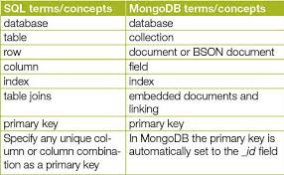
1. SQL Databases (Relational)
SQL databases store data in tables with rows and columns. They use Structured Query Language (SQL) for managing data Examples: MySQL, Oracle, PostgreSQL.

Slide 5
2. NoSQL Databases (Non-Relational)
NoSQL databases store data in flexible formats such as documents, key-value pairs, wide-columns, or graphs. Examples: MongoDB, Redis, Cassandra.
{ "books": [ {
"id": "01",
"language": "Java",
"author": "H. Javeson",
"year": 2015 }
,{
"id": "07",
"language": "C++",
"edition": "second",
"author": "E. Sepp",
"price": 22.25
} ] }

Slide 6
Functions of DBMS
Data storage and retrieval
Backup and recovery
Data security & access control
Concurrency control for multiple users

Slide 7
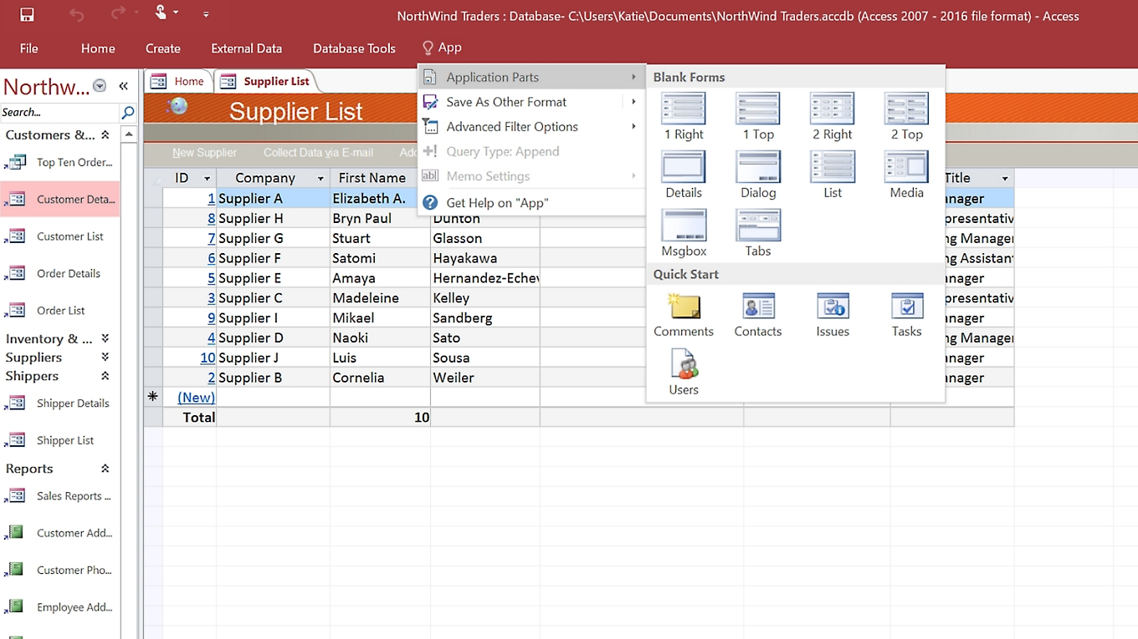
MS Access

Slide 8
Conclusion
A Database Management System (DBMS) helps us store, organize, and manage data in a simple and efficient way. It keeps data safe, reduces mistakes, and makes it easier to find or update information whenever needed. With the help of DBMS, users can handle large amounts of data without confusion and ensure that the data remains accurate and secure. Overall, a DBMS is an important tool that makes working with data faster, smarter, and more reliable.

Slide 9
Thanks

